Slide 1


Dontai Wilson
Jan 28th 2023

Slide 2

Outline
Executive Summary
Introduction
Methodology
Results
Conclusion
Appendix

Slide 3
Executive Summary
Utilizing, verified information from trusted sources, ethically to determine what if any factors have the biggest impact on the successful retrieval of mission assets to help drive down the cost of each mission attempt.
After a detailed analysis of the mission attempts by our competitors we have determined there are a few different parameters that make the difference between a successful mission attempt.

Slide 4
Introduction
With the growth in the Space Race, our company is determined to analyze the predictive metrics from other successful competitors to find the best parameters to ensure our missions are successful and to help drive down the cost to our consumers.
How can we determine if an attempted mission launch will be successfully retrieved?
What are the determining factors to improve the success rates of attempted recovery?

Slide 5

Section 1

Slide 6
Methodology
Executive Summary
Data collection methodology:
Describing how data was collected
Perform data wrangling
Describing how data was processed
Perform exploratory data analysis (EDA) using visualization and SQL
Perform interactive visual analytics using Folium and Plotly Dash
Perform predictive analysis using classification models
How to build, tune, evaluate classification models

Slide 7
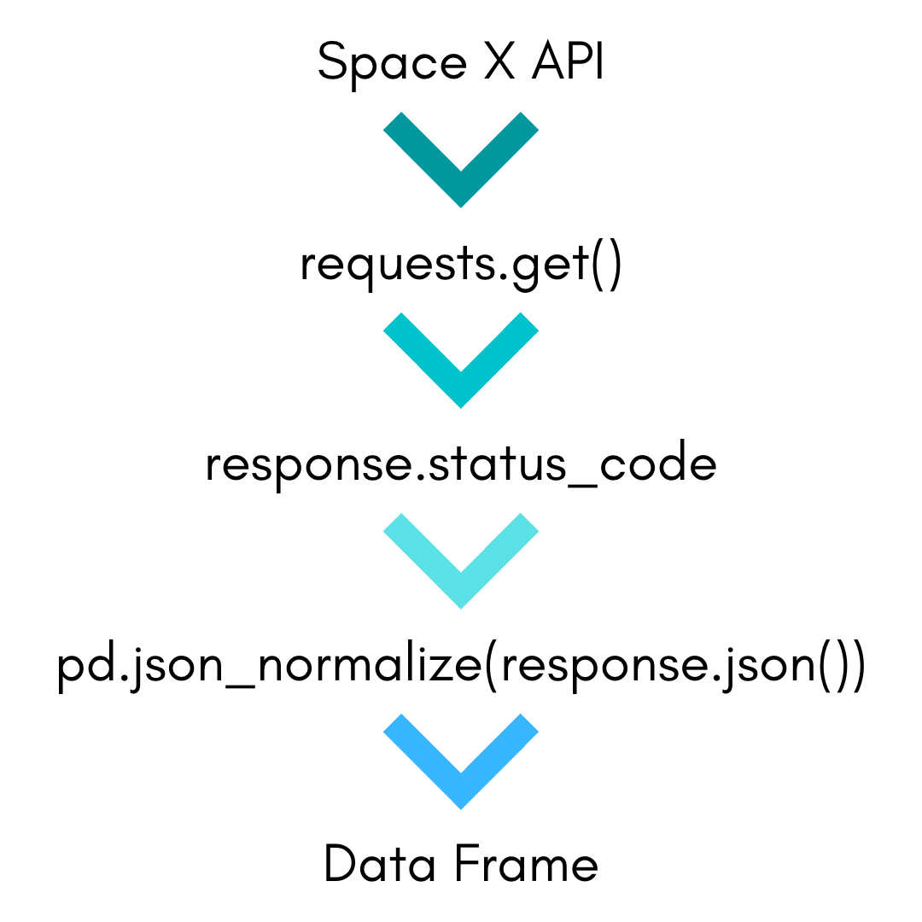
Data Collection – SpaceX API
The Space X API contains massive information about SpaceX launches
I started with requesting rocket launch data from the SpaceX API
Using the response.status_code, we can verify if the request is successful. In our case it returned a 200 which means okay.
I then decoded the response content as a Json using .json() , and turned it into a dataframe using .json_normalize()
Now we having a workable DataFrame, that we can use for further analysis
Git Hub Link to Data Collection API

Slide 8
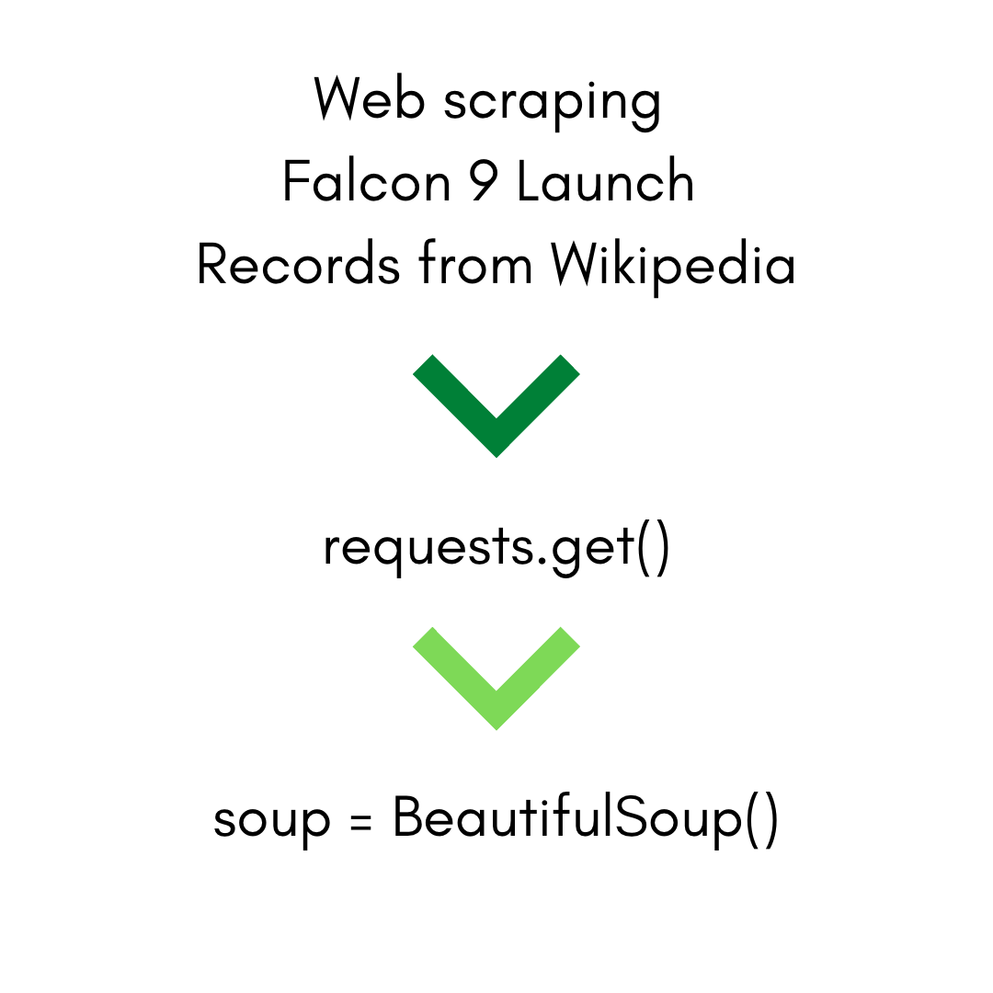
Data Collection - Scraping
Wikipedia hosts historical launch records for Falcon 9 and Falcon Heavy Launches
We’ll utilize web scraping to extract critical data we need. Using the requests.get() to request the HTML page as an HTTP response
We then take advantage of the Beautiful Soup object to create an object that holds the information that I’ll use to draw out a solid conclusion
A Link to the GitHub Code I used for WebScraping

Slide 9
Data Wrangling
For Both the SpaceX API & the Web Scraping I:
Dropped columns that would have no meaning with our objective
Used isnull( ) and replace( ) to find null values and replace them with the mean to better fill in and preserve the data.
Collected the number of Launches per Launch Site with value_counts( ) as well as determining the type of Orbit per launch
Used one hot encoding to convert Object type data into numerical data for calculating impact on the goal.
Left the Data Frame in the perfect state for comparison, and analysis
A Link to the Git Hub Code Used to Wrangle my Data

Slide 10
EDA with Data Visualization
Summarize what charts were plotted and why you used those charts
I choose a variety of charts for a better comparison of the direct relationships between certain data points. Charts such as:
a Scatter Plot, a Bar Plot, and a Line Plot to visualize the relationships between two variables such as; the flight number and the payload mass, as well as the flight number and the launch site that was used, also the payload mass and the launch site that was used, as well as the success rate per year over the last 10 years.
The GitHub link to my EDA Visuals

Slide 11
EDA with SQL
The SQL queries that I performed include:
Determining the Average Payload Weight
I found the boosters that had success in drone ship landings with payloads between 4000 and 6000 KG
Ranked the number of successful landings between 2010 and 2017 by the number of successful attempts.
SQL Queries on Git Hub

Slide 12
Build an Interactive Map with Folium
I utilized an interactive Map with Folium
This map includes the Launch sites, marked on the map to see how close to the equator each lauch site is.
The Clusters of the Launches for each site, to see a visual of how many launches were performed at which location
The success or failure of the launches for each launch site, to get a quick snap shot of the overall success of the launch sites.
Folium Interactive Map on GitHub

Slide 13
Build a Dashboard with Plotly Dash
I utilized Pie charts, and Scatter Plots
The Pie chart compares the success and failure per Launch site or the success rate of all Launch sites
The Scatter Plot shows the correlation between the Payload weight and success of each launch.
The plotly dash allows the user to change the launch site, or payload size per site or overall to do a real time comparison on the relation ship between the variables.
Plotly Dash External Lab on Git Hub

Slide 14
Predictive Analysis (Classification)
After Standardizing the data and we split the data into two groups, Training Data and Testing Data.
We then fit our model with the data and analyzed its performance using Grid Search which tests all the inputted variables and returns the best Parameters for our model.
We then tested the model with the test data we separated from out data pre training and utilized a Confusion Matrix to visualize model performance.
Predictive Analysis on Git Hub

Slide 15
Results
Exploratory data analysis results
Interactive analytics demo in screenshots
Our Predictive Analysis shows that a Regression Tree would be the best performing Model to make predictive estimations, based on its performance on our test data and compared to the other models we fit and tested.

Slide 16

Section 2

Slide 17
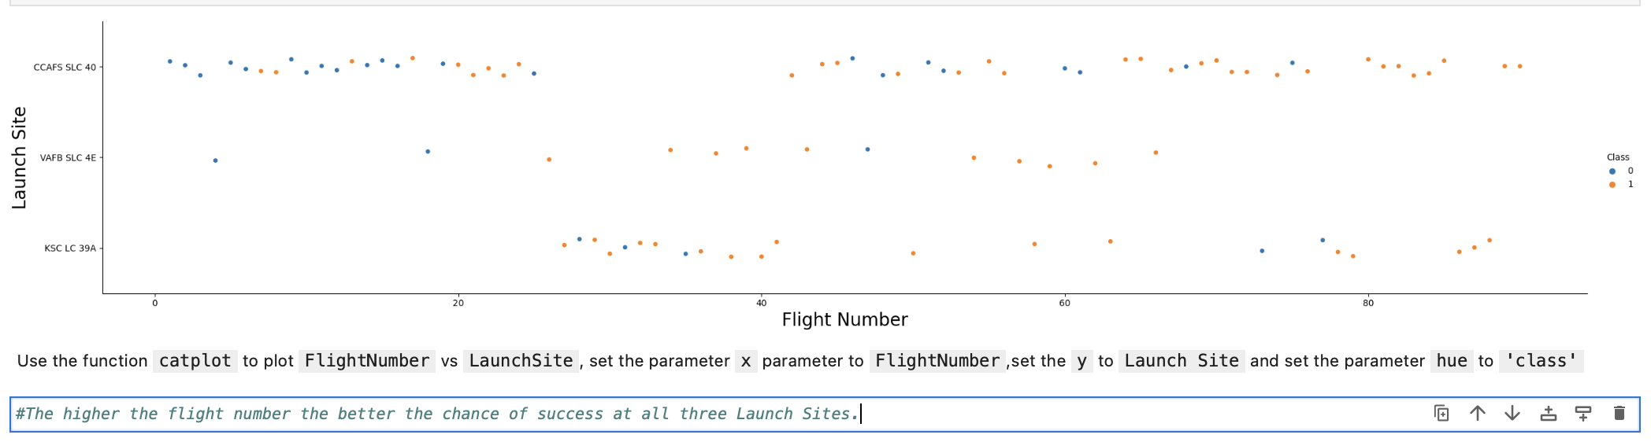
Flight Number vs. Launch Site

Slide 18
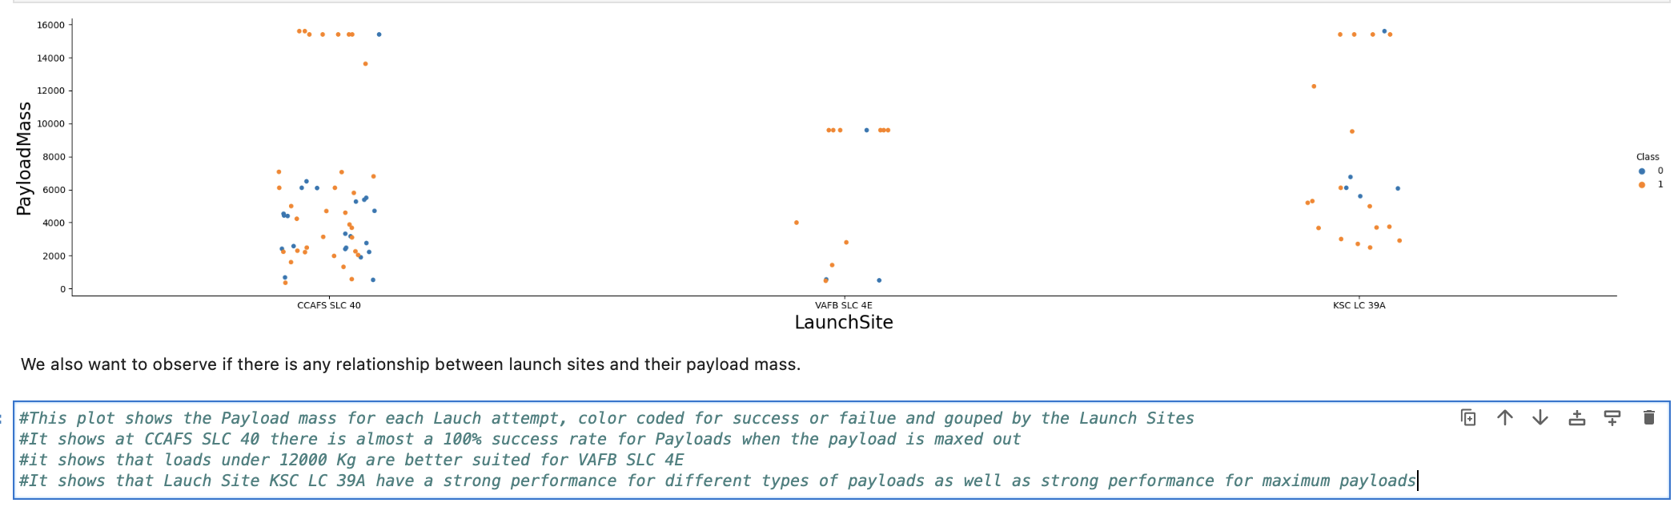
Payload vs. Launch Site

Slide 19
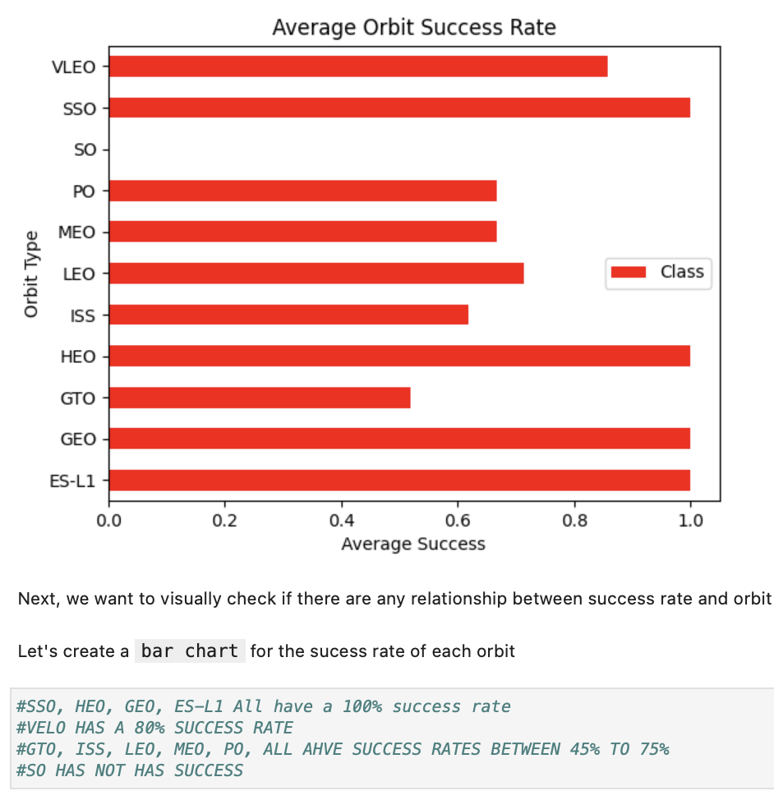
Success Rate vs. Orbit Type

Slide 20
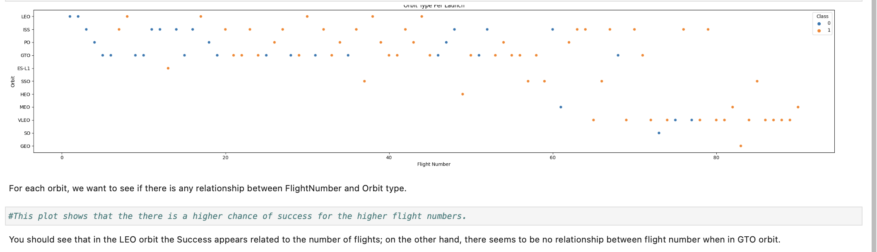
Flight Number vs. Orbit Type

Slide 21
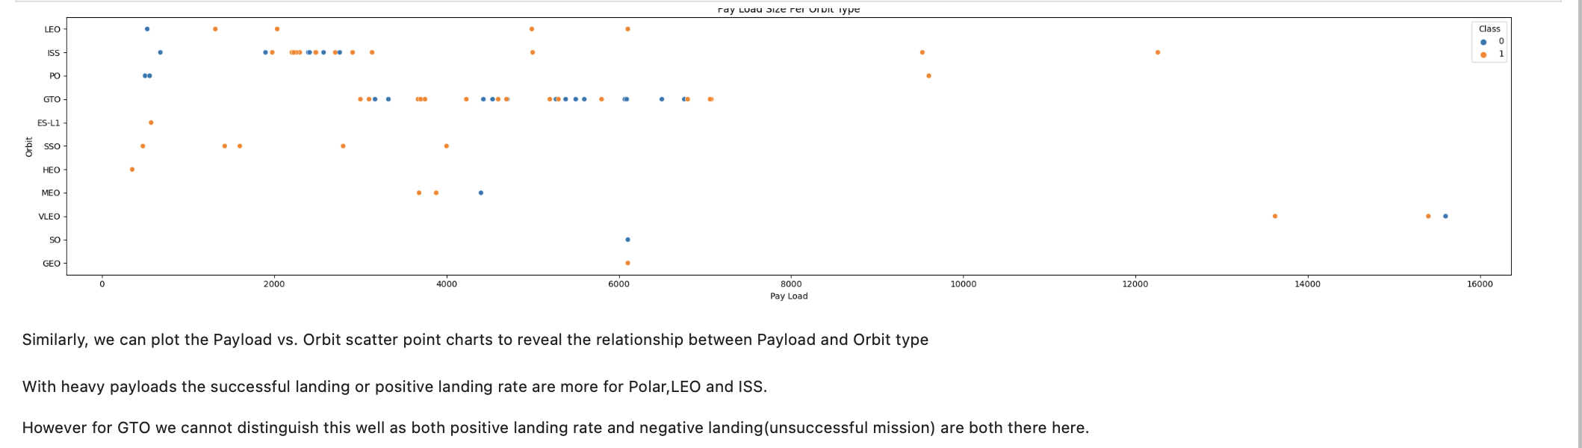
Payload vs. Orbit Type

Slide 22
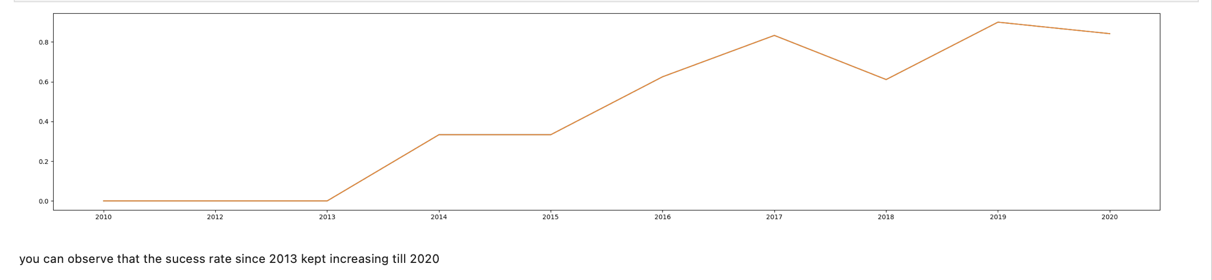
Launch Success Yearly Trend

Slide 23
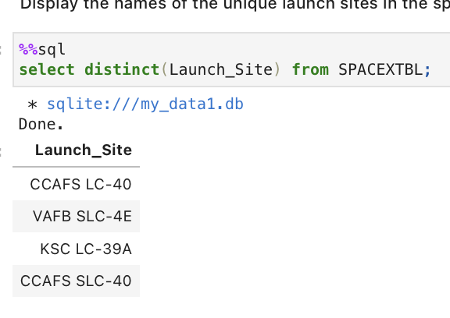
All Launch Site Names
There are Four Launch Sites:
CCAFS LC-40
VAFB SLC-4E
KSC LC-39A
CCAFS SLC-40

Slide 24
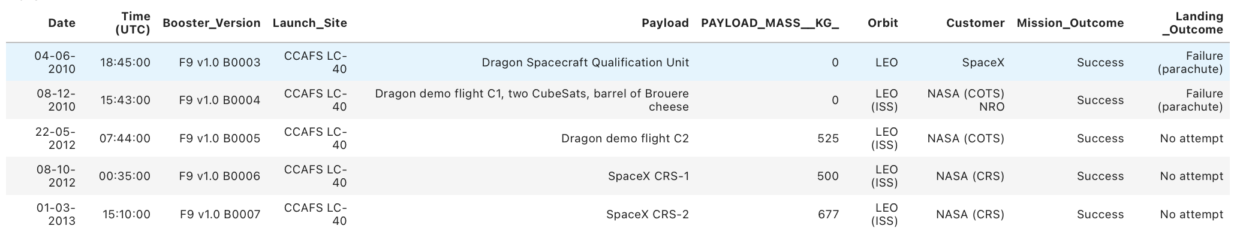
Launch Site Names Begin with 'CCA'
5 Launch Sites and respective data for the Launch sights beginning with ‘CCA’

Slide 25
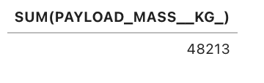
Total Payload Mass
Calculate the total payload carried by boosters from NASA

Slide 26
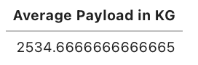
Average Payload Mass by F9 v1.1
Calculate the average payload mass carried by booster version F9 v1.1

Slide 27
First Successful Ground Landing Date
Find the dates of the first successful landing outcome on ground pad
F9 B1032.1 With a payload of 5300Kg to LEO orbit was retrieved.

Slide 28
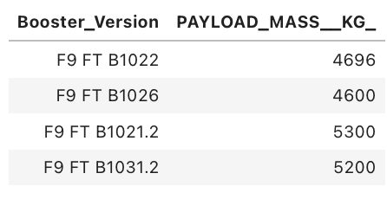
Successful Drone Ship Landing with Payload between 4000 and 6000
List the names of boosters which have successfully landed on drone ship and had payload mass greater than 4000 but less than 6000

Slide 29
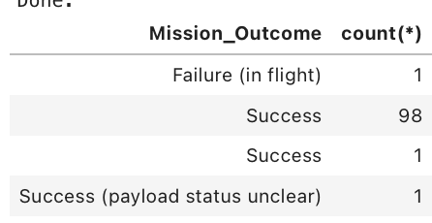
Total Number of Successful and Failure Mission Outcomes
Calculate the total number of successful and failure mission outcomes

Slide 30
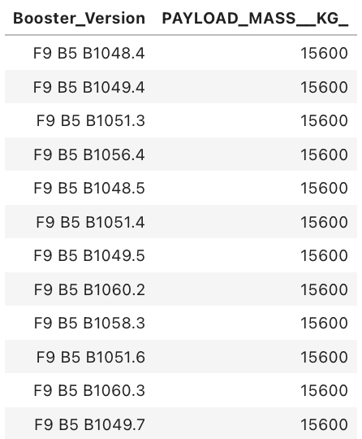
Boosters Carried Maximum Payload
The names of the booster which have carried the maximum payload mass

Slide 31
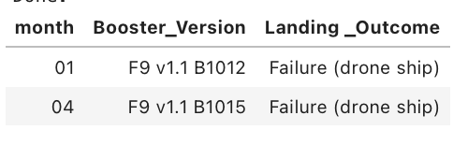
2015 Launch Records
The failed landing outcomes in drone ship, their booster versions, and launch site names for in year 2015

Slide 32
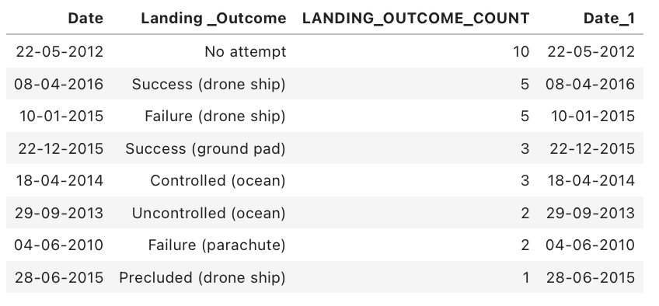
Rank Landing Outcomes Between 2010-06-04 and 2017-03-20
Rank the count of landing outcomes (such as Failure (drone ship) or Success (ground pad)) between the date 2010-06-04 and 2017-03-20, in descending order

Slide 33

Section 3

Slide 34
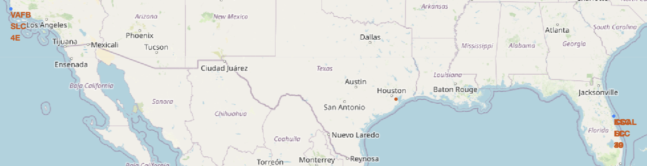
Launch Site Locations
Replace <Folium map screenshot 1> title with an appropriate title
Explore the generated folium map and make a proper screenshot to include all launch sites’ location markers on a global map
The Blue markers represent the Launch Site Locations
The Orange Tag is the Name of the Launch Sites

Slide 35
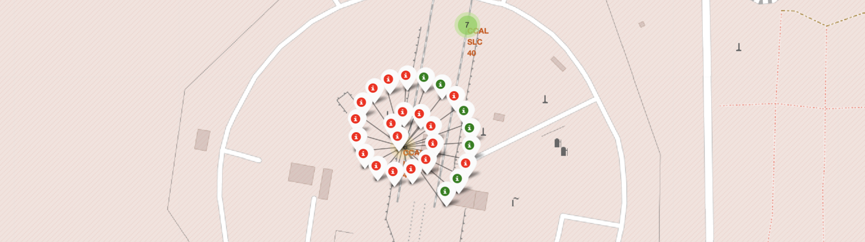
Folium Map Success/Failed Clusters
The red dots indicate the failure of the launches
The green dots indicate success of the launches
This cluster is for the CCAL LC-40 Launch Site

Slide 36
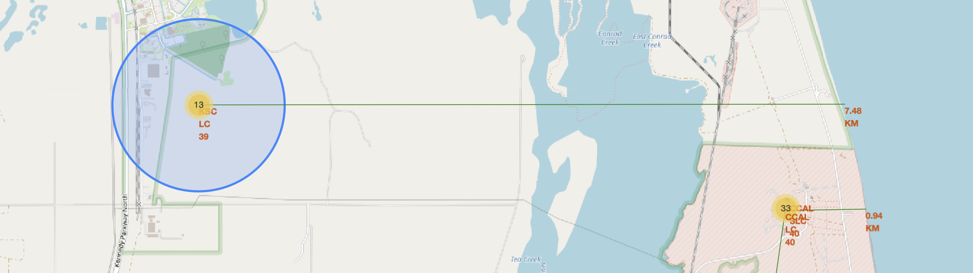
Florida Launch Sites Distance to Coast Line
Replace <Folium map screenshot 3> title with an appropriate title
Explore the generated folium map and show the screenshot of a selected launch site to its proximities such as railway, highway, coastline, with distance calculated and displayed
Distance from Launch Sites in Florida to East Coast Line

Slide 37

Section 4

Slide 38
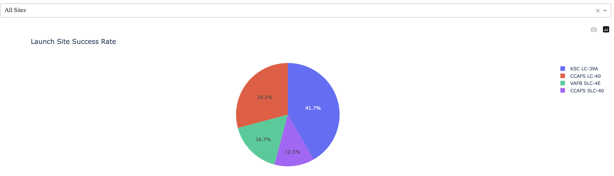
Launch Success Count All Launch Sites
screenshot of launch success count for all sites, in a pie chart

Slide 39
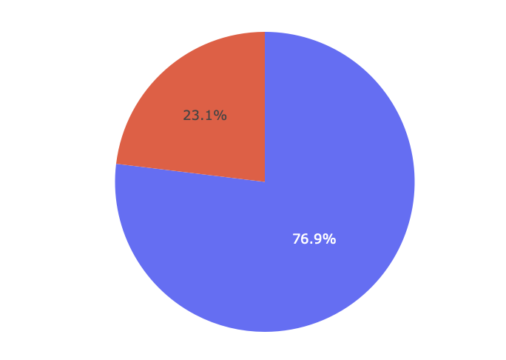
Launch Site with the highest Success Ratio
Success Ratio of KSC LC 39A

Slide 40
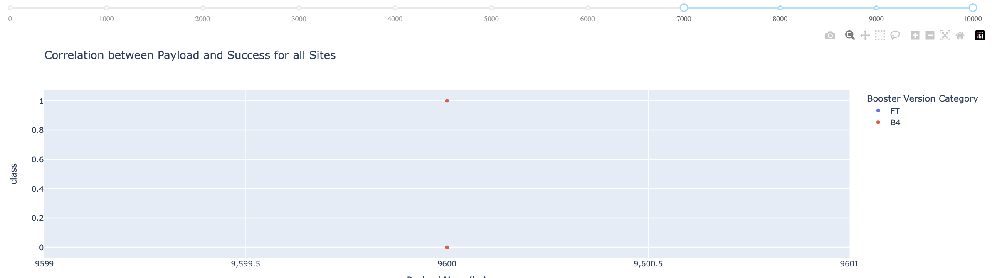
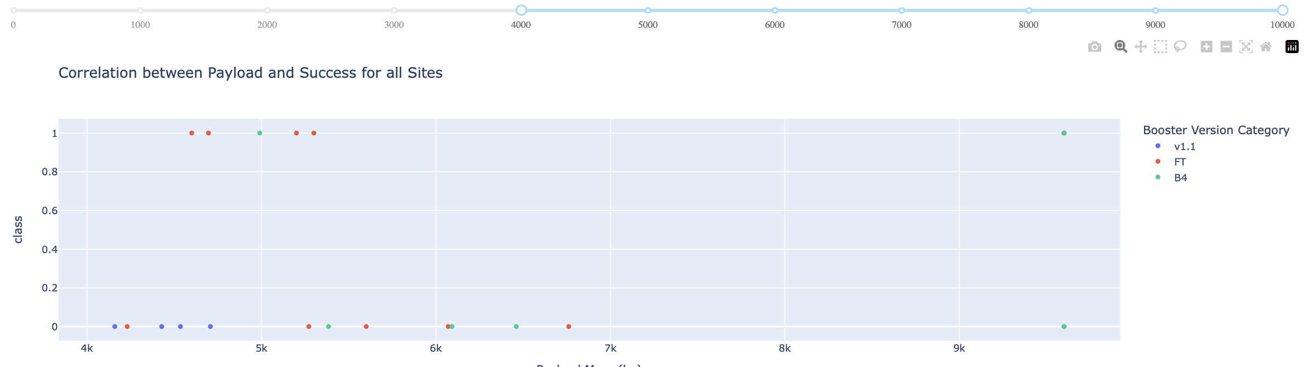
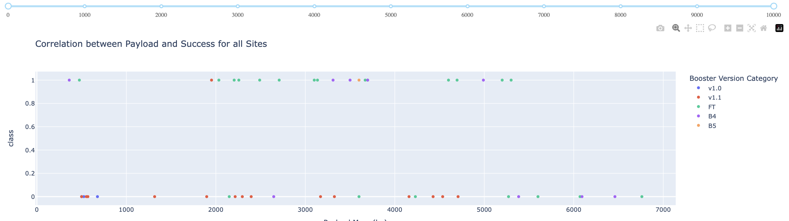
Payload Vs Launch with different Ranges of Payload
7000 to 10000
Only two boosters carried a payload and only one succeeded
4000 to 10000
13 successful launches and 6 failed attempts between this weight
0 to 10000
There were more successful attempts than failed, with the successful attempts having a broad range

Slide 41

Section 5

Slide 42
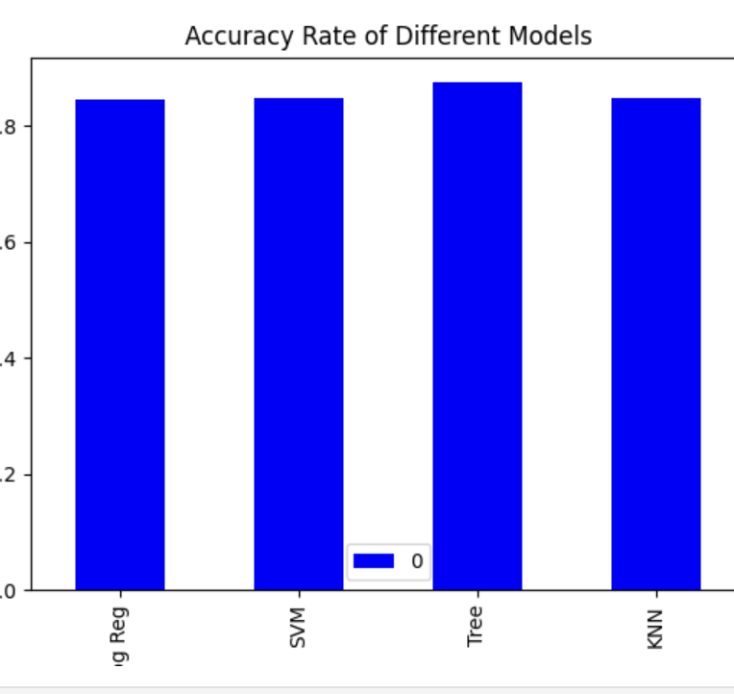
Classification Accuracy
The Tree Model Has the Highest Accuracy Ratings Out of All the Models

Slide 43
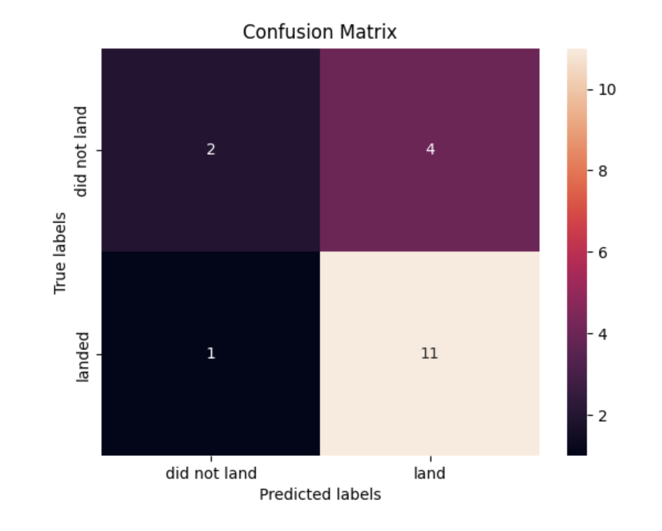
Confusion Matrix
The Tree Model predicted the most accurate results based on our training. The actual data sets the landed at 12 and did not at 6 and the model predicted 15 landed and 3 did not which was higher than the other models.

Slide 44
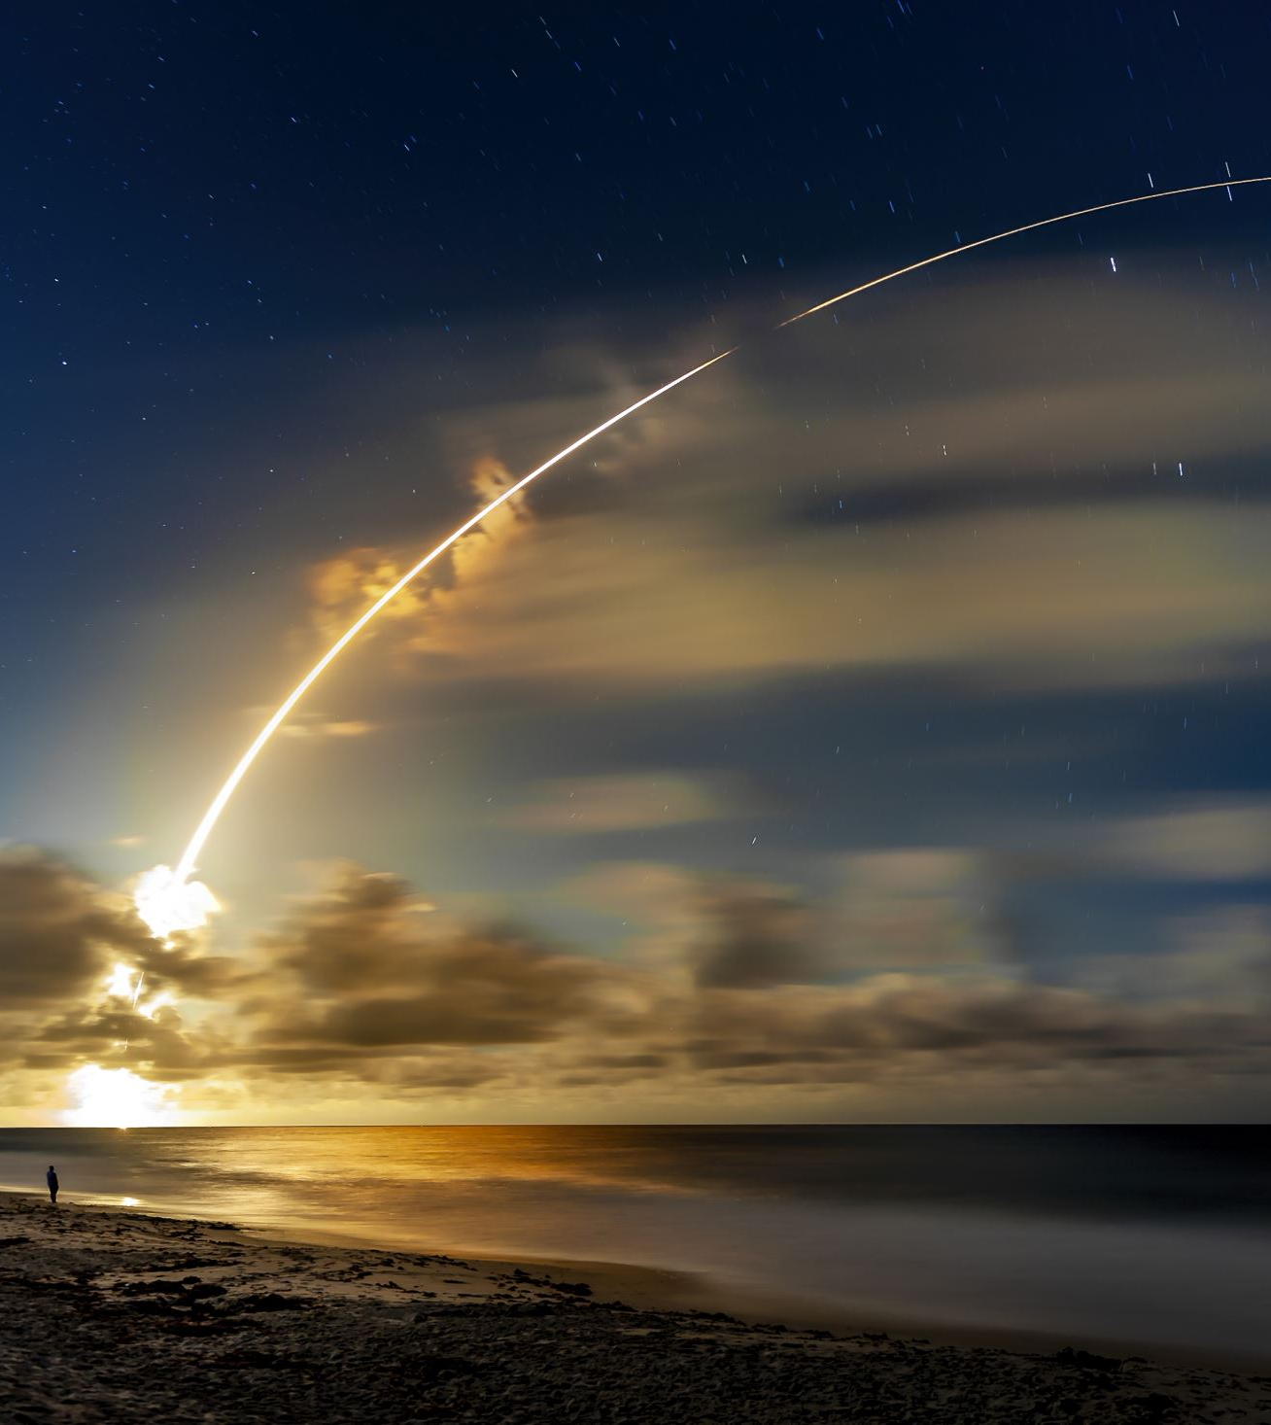
Conclusions
When it comes to determining if a mission will land or not there are several factors that we take into consideration to determine the success rate
The Payload size, the intended orbit type, launch location, and more, have a dramatic impact on the success of a mission attempt and with the right information we can predict success.
Using the predictive model built with a Regression Tree, we can give the expected accuracy with a confidence of 87.5%.

Slide 45

Appendix
Skills Network Labs: used to build and run the code, models and Plotly Dash App
Data used from SpaceX API
Data used from Wikipedia
All Instructors and Course Authors in the IBM Data Science Program.

Slide 46


